Slide 1

Crystal Advanced Analytics
Milestone 5
Harshil Haumeer

Slide 2
Client: Dr. Richard Griffith Department of Psychology Faculty Sponsor:
Dr. Philip Chan
Department of Computer Science

Slide 3
Progress of Current Milestone
Task | Completion | To do
Complete implementation, test and demo of Benchmarking tool | 100% | None
Implement, Test and Demo Root-Cause Analysis | 100% | None
Implement graphs on Dashboard | 80% | Implement sentiment analysis graph and visualization for root cause analysis
Improve website | 90% | Implement more graphs and all necessary remaining components.
Showcase Poster | 100% | None

Slide 4
Discussion of each accomplished task for current milestone:
Task 1: Complete implementation, test and demo of Benchmarking tool
Benchmarking tool was successfully implemented
Allows benchmarking of up to 4 competitors
Benchmark services by customer ratings and sentiment score
Sorted by most recent by default
Task 2: Implement, Test and Demo Root-Cause Analysis
Root-cause analysis tool was successfully implemented
Tokenize reviews
Filter out stop words: Meaningless data with high frequency
Sorted 2-D array with most frequent word and respective frequency
Represented on a bar-graph
Allows user to identify root cause for underperforming and over performing service(s)
Defining threshold for under performance or over performance is set by user

Slide 5
Discussion of each accomplished task for current milestone:
Task 3: Implement graphs on Dashboard
Relevant graphs were implemented to represent different types of data
Bar-graphs: Benchmarking, Root cause analysis
Benchmarking component
Add filter for date range
Task 4: Improve website
Improved Home Page
Added new components to dashboard
Service Overview, Benchmarking, Root-Cause analysis
Task 5: Showcase Poster
Completed showcase poster

Slide 6
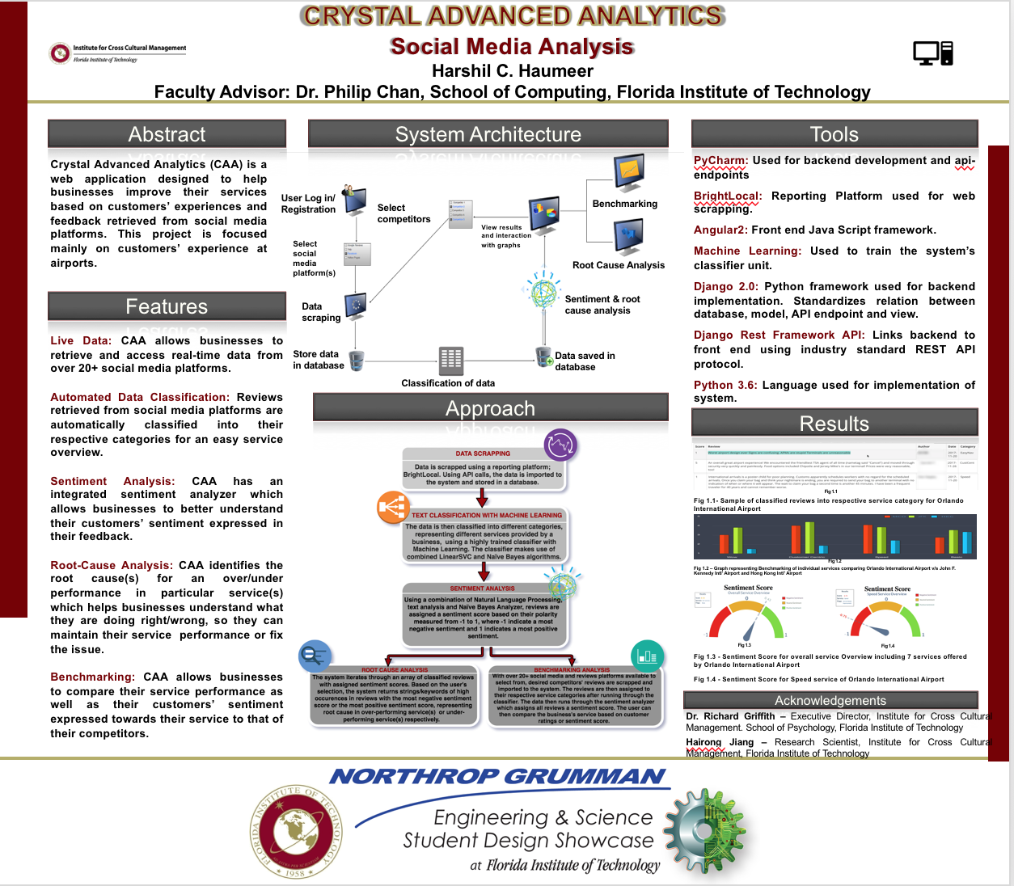
Showcase Poster

Slide 7
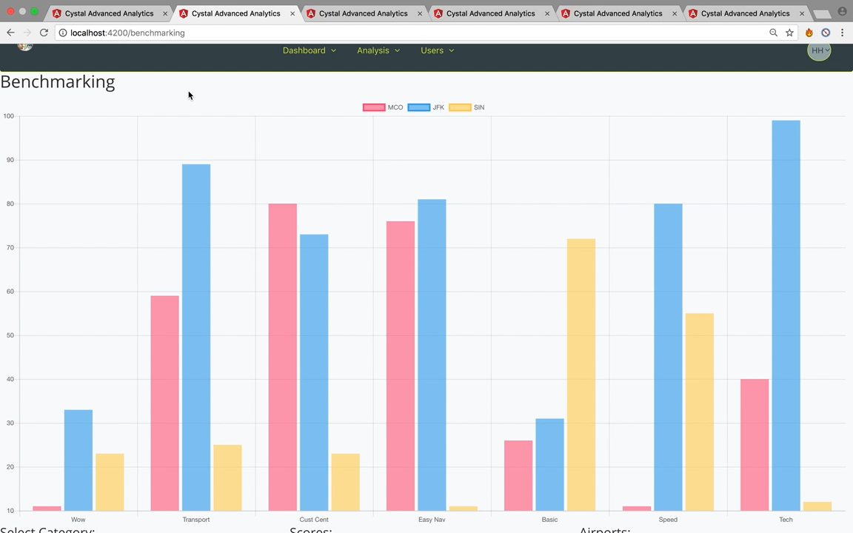
Demo: Benchmarking Tool

Slide 8
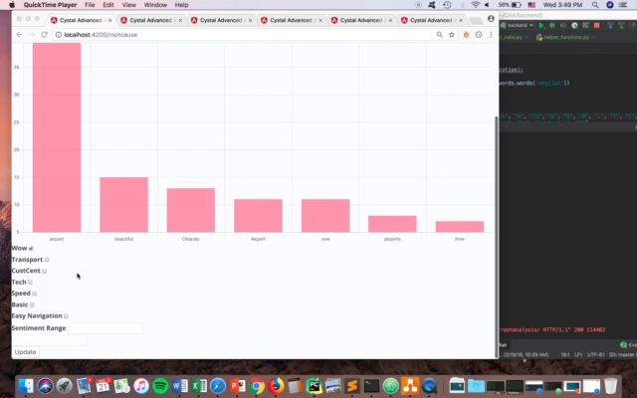
Demo: Root-Cause Analysis Tool

Slide 9
Plan for Next Milestone
Task | Harshil
1. Complete and test website | 100%
2. Complete E-book page | 100%
3. Create Demo Video | 100%
4. Create User Manual | 100%

